Slide 1
Chapter 3: Process Management

Slide 2
Important Terminologies
Task: A program that is requested for execution
i.e. before pressing the enter key
Job: When the OS checks the validity of the task by searching it in internal page table, if present then it is said to be a valid job for further processing.
Process: A job that is ready for execution after being loaded into main memory.

Slide 3
Process Management
A process is a program in execution.
It is a unit of work within the system.
Program is a passive entity, process is an active entity.
Process needs resources to accomplish its task
CPU, memory, I/O, files
Initialization data
Process termination requires reclaim of any reusable resources

Slide 4
Example
When we write on the console,
C:\>dir
A task has been given to OS
OS checks its validity by searching it into internal table, if found, then it is valid, become a job
When it become a job, OS must load it into memory.
Now this program under execution along with its environment is called a Process.

Slide 5
Process Management
Single-threaded process has one program counter specifying location of next instruction to execute
Process executes instructions sequentially, one at a time, until completion
Multi-threaded process has one program counter per thread
Typically system has many processes, some users, some operating system running concurrently on one or more CPUs
Concurrency by multiplexing the CPUs among the processes / threads

Slide 6
Process Management Activities
The operating system is responsible for the following activities in connection with process management:
Creating and deleting both user and system processes
Suspending and resuming processes
Providing mechanisms for process synchronization
Providing mechanisms for process communication
Providing mechanisms for deadlock handling

Slide 7
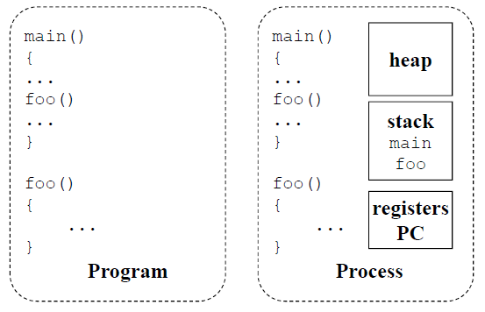
Program vs. Process

Slide 8
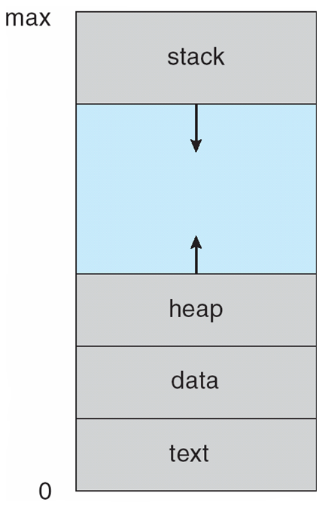
Process in Memory
A process has multiple parts
The program code, also called text section
Current activity including program counter, processor registers
Stack containing temporary data
Function parameters, return addresses, local variables
Data section containing global variables
Heap containing memory dynamically allocated during run time

Slide 9
Users, Programs, Processes
Users have account on the system
Users launch programs
Can many users launch same program?
Can one user launch many instances of the same program?
A process is an instance of a program
A “program” can be a set of programs
A “program” can be a set of processes

Slide 10
Programs as Process Collections
gcc (via “gcc –pipe -v”)
/usr/libexec/cpp |
/usr/libexec/cc1 |
/usr/libexec/as, followed by
/usr/libexec/elf/ld

Slide 11
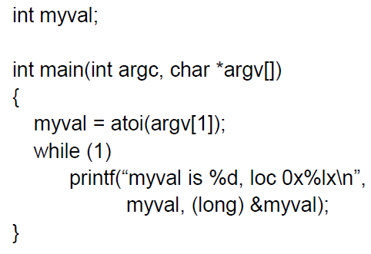
What does this Program do?

Slide 12
Instances of Programs
The address was always the same!
The values were different!
Implications:
Do programs think they’re using the same address?
Are they seeing each other?
Conclusion: addresses are not absolute
What are the benefits?

Slide 13
Process Creation
Parent process create children processes, which in turn create other processes, forming a tree of processes
Generally, every process is identified and managed via a process identifier (pid)
Who created process cpp?
Who created gcc?
Who created shell?

Slide 14
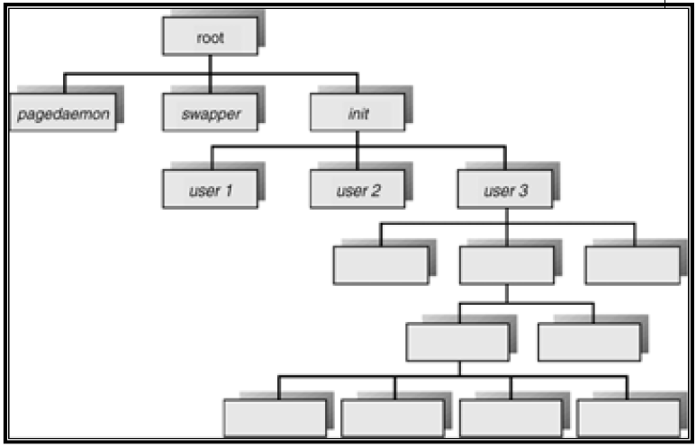
Processes Tree on a UNIX System

Slide 15
Processes Tree on a UNIX System

Slide 16
Process Creation: Design Options
Resource sharing options
Parent and children share all resources
Children share subset of parent’s resources
Parent and child share no resources
Execution options
Parent and children execute concurrently
Parent waits until children terminate

Slide 17
Process Termination
Process executes last statement and asks the operating system to delete it (exit())
Output data from child to parent (via wait())
Process resources are de-allocated by operating system

Slide 18
Process Termination
Parent may terminate execution of children processes (abort())
Child has exceeded allocated resources
Task assigned to child is no longer required
If parent is exiting
Some operating systems do not allow child to continue if its parent terminates
All children terminated - cascading termination

Slide 19
So what is a Process?
It’s one instance of a “program”
It’s separate from other instances
It can start (“launch”) other processes
It can be launched by them

Slide 20
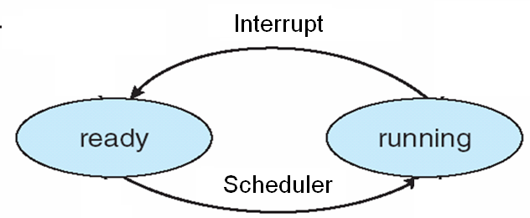
Process State
As a process executes, it changes the state
Ready: The process is waiting to be assigned to a processor
Running: Instructions are being executed

Slide 21

Interrupts
The occurrence of an event is usually signaled by an interrupt from either the hardware or the software.
Hardware may trigger an interrupt at any time by sending a signal to the CPU usually by way of the system bus.
Software may trigger an interrupt by executing a special operation called a system call.
Answer the Phone
.
Resume

Slide 22
Example
Process | Burst Time | Start/Arrival Time
P1 | 40 sec | 0 sec
P2 | 40 sec | 0 sec
CPU time slice = 10 sec

Slide 23
P1 & P2 States
Process | Burst Time | Start/Arrival Time
P1 | 40 sec | 0 sec
P2 | 40 sec | 0 sec
CPU time slice = 10 sec
Time Instant | P1 | P2
0 | Running | Ready
10
20
30
40
50
60
70

Slide 24
P1 & P2 States
Process | Burst Time | Start/Arrival Time
P1 | 40 sec | 0 sec
P2 | 40 sec | 0 sec
CPU time slice = 10 sec
Time Instant | P1 | P2
0 | Running | Ready
10 | Ready | Running
20
30
40
50
60
70

Slide 25
P1 & P2 States
Process | Burst Time | Start/Arrival Time
P1 | 40 sec | 0 sec
P2 | 40 sec | 0 sec
CPU time slice = 10 sec
Time Instant | P1 | P2
0 | Running | Ready
10 | Ready | Running
20 | Running | Ready
30
40
50
60
70

Slide 26
P1 & P2 States
Process | Burst Time | Start/Arrival Time
P1 | 40 sec | 0 sec
P2 | 40 sec | 0 sec
CPU time slice = 10 sec
Time Instant | P1 | P2
0 | Running | Ready
10 | Ready | Running
20 | Running | Ready
30 | Ready | Running
40
50
60
70

Slide 27
P1 & P2 States
Process | Burst Time | Start/Arrival Time
P1 | 40 sec | 0 sec
P2 | 40 sec | 0 sec
CPU time slice = 10 sec
Time Instant | P1 | P2
0 | Running | Ready
10 | Ready | Running
20 | Running | Ready
30 | Ready | Running
40 | Running | Ready
50
60
70

Slide 28
P1 & P2 States
Process | Burst Time | Start/Arrival Time
P1 | 40 sec | 0 sec
P2 | 40 sec | 0 sec
CPU time slice = 10 sec
Time Instant | P1 | P2
0 | Running | Ready
10 | Ready | Running
20 | Running | Ready
30 | Ready | Running
40 | Running | Ready
50 | Ready | Running
60
70

Slide 29
P1 & P2 States
Process | Burst Time | Start/Arrival Time
P1 | 40 sec | 0 sec
P2 | 40 sec | 0 sec
CPU time slice = 10 sec
Time Instant | P1 | P2
0 | Running | Ready
10 | Ready | Running
20 | Running | Ready
30 | Ready | Running
40 | Running | Ready
50 | Ready | Running
60 | Running | Ready
70

Slide 30
P1 & P2 States
Process | Burst Time | Start/Arrival Time
P1 | 40 sec | 0 sec
P2 | 40 sec | 0 sec
CPU time slice = 10 sec
Time Instant | P1 | P2
0 | Running | Ready
10 | Ready | Running
20 | Running | Ready
30 | Ready | Running
40 | Running | Ready
50 | Ready | Running
60 | Running | Ready
70 | - | Running

Slide 31
Class Exercise

Slide 32
Example
Process | Burst Time | Start/Arrival Time
P1 | 30 sec | 0 sec
P2 | 50 sec | 0 sec
CPU time slice = 10 sec

Slide 33
P1 & P2 States
Process | Burst Time | Start/Arrival Time
P1 | 30 sec | 0 sec
P2 | 50 sec | 0 sec
CPU time slice = 10 sec
Time Instant | P1 | P2
0 | Running | Ready
10
20
30
40
50
60
70

Slide 34
P1 & P2 States
Process | Burst Time | Start/Arrival Time
P1 | 30 sec | 0 sec
P2 | 50 sec | 0 sec
CPU time slice = 10 sec
Time Instant | P1 | P2
0 | Running | Ready
10 | Ready | Running
20
30
40
50
60
70

Slide 35
P1 & P2 States
Process | Burst Time | Start/Arrival Time
P1 | 30 sec | 0 sec
P2 | 50 sec | 0 sec
CPU time slice = 10 sec
Time Instant | P1 | P2
0 | Running | Ready
10 | Ready | Running
20 | Running | Ready
30
40
50
60
70

Slide 36
P1 & P2 States
Process | Burst Time | Start/Arrival Time
P1 | 30 sec | 0 sec
P2 | 50 sec | 0 sec
CPU time slice = 10 sec
Time Instant | P1 | P2
0 | Running | Ready
10 | Ready | Running
20 | Running | Ready
30 | Ready | Running
40
50
60
70

Slide 37
P1 & P2 States
Process | Burst Time | Start/Arrival Time
P1 | 30 sec | 0 sec
P2 | 50 sec | 0 sec
CPU time slice = 10 sec
Time Instant | P1 | P2
0 | Running | Ready
10 | Ready | Running
20 | Running | Ready
30 | Ready | Running
40 | Running | Ready
50
60
70

Slide 38
P1 & P2 States
Process | Burst Time | Start/Arrival Time
P1 | 30 sec | 0 sec
P2 | 50 sec | 0 sec
CPU time slice = 10 sec
Time Instant | P1 | P2
0 | Running | Ready
10 | Ready | Running
20 | Running | Ready
30 | Ready | Running
40 | Running | Ready
50 | - | Running
60
70

Slide 39
P1 & P2 States
Process | Burst Time | Start/Arrival Time
P1 | 30 sec | 0 sec
P2 | 50 sec | 0 sec
CPU time slice = 10 sec
Time Instant | P1 | P2
0 | Running | Ready
10 | Ready | Running
20 | Running | Ready
30 | Ready | Running
40 | Running | Ready
50 | - | Running
60 | - | Running
70

Slide 40
P1 & P2 States
Process | Burst Time | Start/Arrival Time
P1 | 30 sec | 0 sec
P2 | 50 sec | 0 sec
CPU time slice = 10 sec
Time Instant | P1 | P2
0 | Running | Ready
10 | Ready | Running
20 | Running | Ready
30 | Ready | Running
40 | Running | Ready
50 | - | Running
60 | - | Running
70 | - | Running

Slide 41
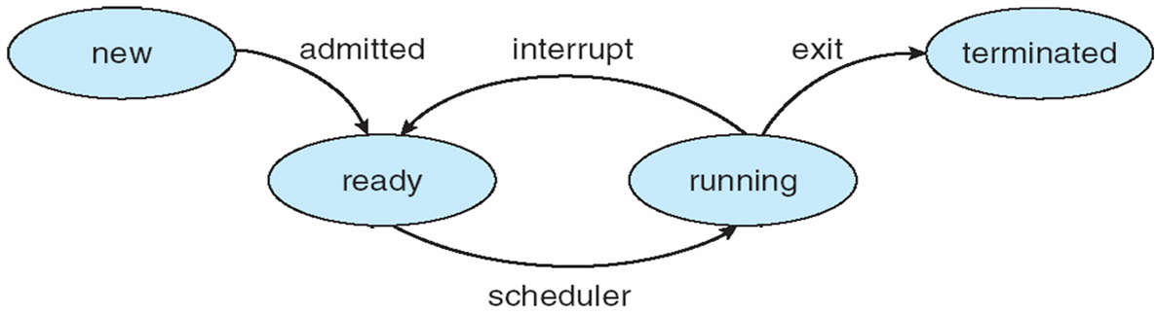
Process State Modified
As a process executes, it changes state
New: The process is being created
Ready: The process is waiting to be assigned to a processor
Running: Instructions are being executed
Terminated: The process has finished execution

Slide 42
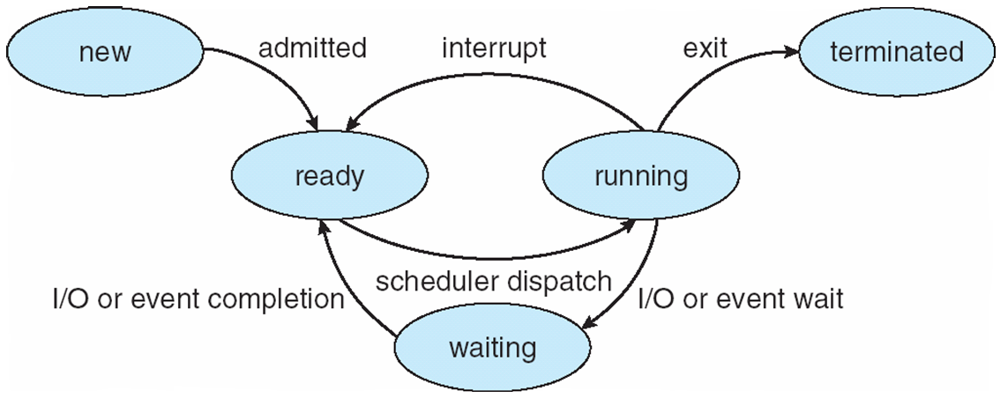
Process State Modified
As a process executes, it changes state
New: The process is being created
Ready: The process is waiting to be assigned to a processor
Running: Instructions are being executed
Waiting: The process is waiting for some event to occur
Terminated: The process has finished execution

Slide 43
Example
Process | Burst Time | Start/Arrival Time
P1 | 40 sec | 0 sec
P2 | 40 sec | 0 sec
CPU time slice = 10 sec
P1 does an I/O for 10 sec at 20
P2 does an I/O for 20 sec at 40

Slide 44
P1 & P2 States
Process | Burst Time | Start/Arrival Time
P1 | 40 sec | 0 sec
P2 | 40 sec | 0 sec
CPU time slice = 10 sec
Time Instant | P1 | P2
0 | Running | Ready
10 | Ready | Running
20 | Blocked for I/O | Running
30 | Running | Ready
40 | Running | Blocked for I/O
50 | Running | Blocked for I/O
60 | Exit | Running
70 | - | Running
 |  | Exit

Slide 45
Class Exercise

Slide 46
Example
Process | Burst Time | Start/Arrival Time
P1 | 40 sec | 0 sec
P2 | 40 sec | 0 sec
CPU time slice = 10 sec
P1 does an I/O for (10 x 2) sec at 20 and 50
P2 does an I/O for (10 x 2) sec at 40 and 60

Slide 47
P1 & P2 States
Process | Burst Time | Start/Arrival Time
P1 | 40 sec | 0 sec
P2 | 40 sec | 0 sec
CPU time slice = 10 sec
Time Instant | P1 | P2
0 | Running | Ready
10 | Ready | Running
20 | Blocked for I/O | Running
30 | Running | Ready
40 | Running | Blocked for I/O
50 | Blocked for I/O | Running
60 | Running | Blocked for I/O
70 | Exit | Running
 |  | Exit

Slide 48
To make sure… You have Understood !
Process | Burst Time | Start/Arrival Time
P1 | 30 sec | 0 sec
P2 | 40 sec | 0 sec
CPU time slice = 10 sec
P1 does an I/O for 10 sec at 20
P2 does an I/O for 30 sec at 30

Slide 49
P1 & P2 States
Process | Burst Time | Start/Arrival Time
P1 | 30 sec | 0 sec
P2 | 40 sec | 0 sec
CPU time slice = 10 sec
Time Instant | P1 | P2
0 | Running | Ready
10 | Ready | Running
20 | Blocked for I/O | Running
30 | Running | Blocked for I/O
40 | Running | Blocked for I/O
50 | Exit | Blocked for I/O
60 | - | Running
70 | - | Running
 |  | Exit

Slide 50
Context Switch
Definition: Switching the CPU to another process, which involves saving the state of the old process and load the state of the new process
Enables multiple processes to share a single CPU
Essential feature of a multitasking operating system
Helps resume execution of a process from the same point at a later time
Context switches are usually computationally intensive
much of the design of operating systems is to optimize the use of context switches
What State?
Where to store them?

Slide 51
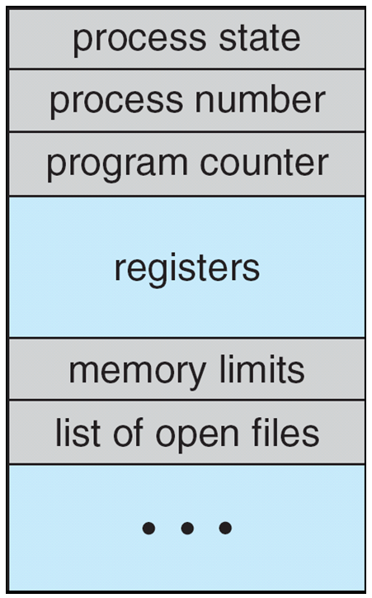
Process Control Block (PCB)
Process management information
Process state (running, ready, waiting)
PC & CPU registers, parents, etc.
CPU scheduling information (priorities, etc.)
Memory-management information
memory allocated to the process (segments, page tables etc.)
Accounting information – CPU used, clock time elapsed since start, time limits
I/O and file management
Communication ports, directories, file descriptors etc.,

Slide 52
Context Switch
Definition: Switching the CPU to another process, which involves saving the state of the old process and load the state of the new process
Enables multiple processes to share a single CPU
Essential feature of a multitasking operating system
Helps resume execution of a process from the same point at a later time
What State?
What about L1/L2 cache content?
Where to store them? In the PCB.
Context switches are usually computationally intensive and much of the design of operating systems is to optimize the use of context switches
Context-switch time is overhead; the system does no useful work while switching
The more complex the OS and the PCB ➔ the longer the context switch
Time dependent on hardware support
Some hardware provides multiple sets of registers per CPU ➔ multiple contexts loaded at once

Slide 53
Context Switch
The following steps are needed for a context switch to occur:
Save the values of the program counter, registers, stack pointer.
Change the process state in the PCB from running state to blocked state.
Update the various times for process accounting information.
Select a new process for execution.
Update the state field in its PCB to running.
Update memory management related information.
Change the context of the CPU to the new process by loading the values of program counter and registers that were saved earlier.

Slide 54
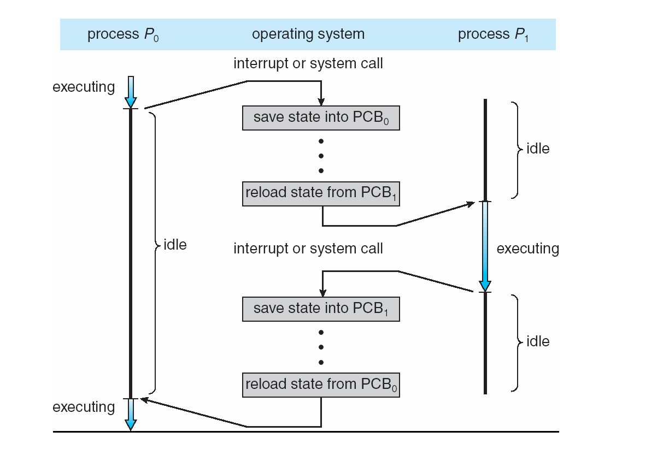
CPU Switch From Process to Process

Slide 55
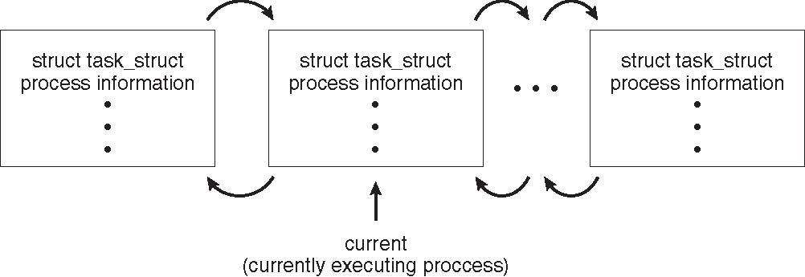
Process Representation in Linux
Represented by the C structure task_struct
pid t_pid; /* process identifier */ long state; /* state of the process */ unsigned int time_slice /* scheduling information */ struct task_struct *parent; /* this process’s parent */ struct list_head children; /* this process’s children */ struct files_struct *files; /* list of open files */ struct mm_struct *mm; /* address space of this process */

Slide 56
Sequential execution of each Process
No concurrency inside a process
Everything happens sequentially
Often with interleaved CPU/IO operations

Slide 57
Concurrent Processes
Processes in a system can execute concurrently (multitasking)
Concurrently vs. simultaneously
Reason for allowing concurrent execution
Physical resource sharing (system utilization)
Computational speedup – with several CPUs
Modularity (netscape)
Convenience (xload, xclock, emacs, xterm, twm)

Slide 58
Process Creation/Termination
Who should actually create/terminate processes? (bring program to life)
Who manages processes?
But user process decides when and what
What should be the semantics of the interface be?
The system call creates a child process

Slide 59
Policy vs. Mechanism
When fork( ) creates a child process
Execution possibilities?
Parent and child execute concurrently
Parent wait till child finishes
Concurrency?
Address space possibilities?
Child duplicate of parent (code and data)
Child has new program loaded into it
Resource sharing options
Parent and children share all resources
Children can share a subset of parent resources
Parent and child share no resources

Slide 60
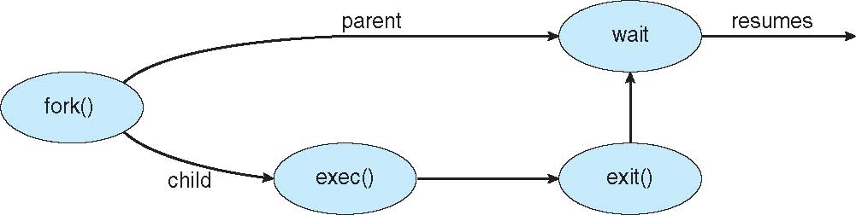
Process Creation – UNIX examples
fork( ) system call creates a duplicate of the original process
What is the major benefit?
Allows the two to communicate
How to disambiguate who is who?
exec( ) system call used after a fork( ) to replace the process’ memory space (both code and address spaces) with a new program

Slide 61
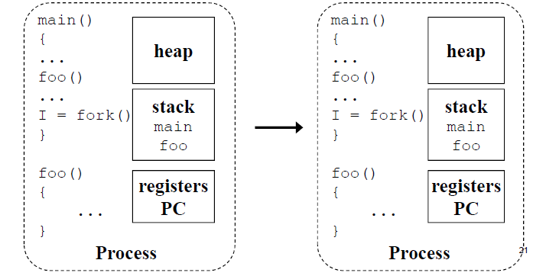
fork( )

Slide 62
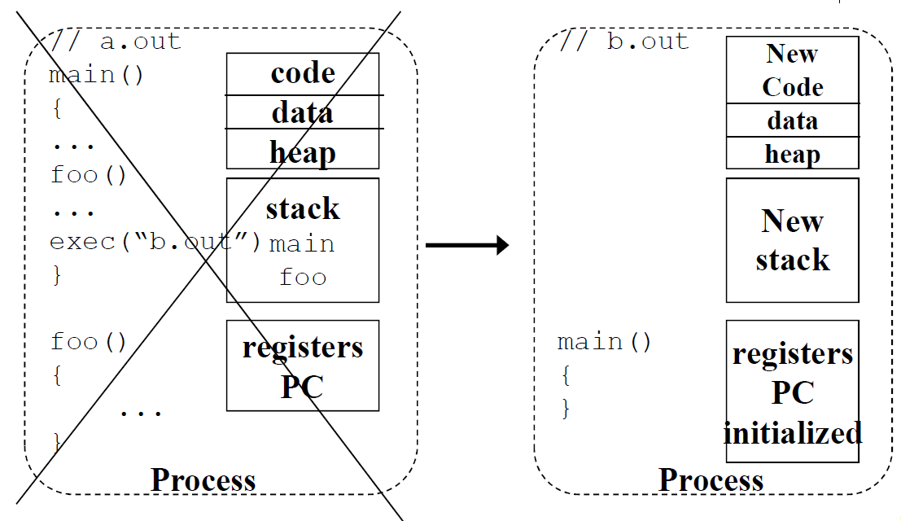
exec(“b.out”)
Afterwards, only one thing about the process was kept, what?

Slide 63
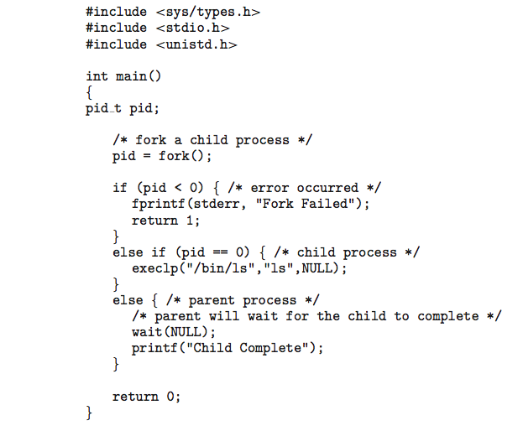
C Program Forking a new Process

Slide 64
Process Creation – UNIX interfaces
UNIX has 4 system calls:
fork( ) -- creates a copy of the original process
Clone would have been a better name!
exec( ) -- replaces this process with this program
wait( ) – wait for child process to finish
kill( ) – (potentially) end a running process

Slide 65
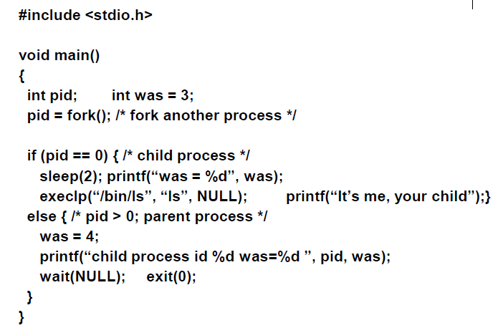
C Program Forking a new Process

Slide 66
Process Termination
Process executes the last statement and asks the operating system to delete it using exit() system call. Process resources are de-allocated by operating system.
Output data from child to parent (via wait())
What happens when a parent process disappears?
All child processes are killed by the OS or reset init as their parent
Parent may wait for termination of child process using pid = wait(&status);
If no parent waiting (did not invoke wait()) process is a zombie
If parent terminated without invoking wait , process is an orphan
Parent may terminate execution of children processes
Child has exceeded allocated resources or task assigned is no longer required
If parent is exiting (all children terminated - cascading termination)

